Slide 1
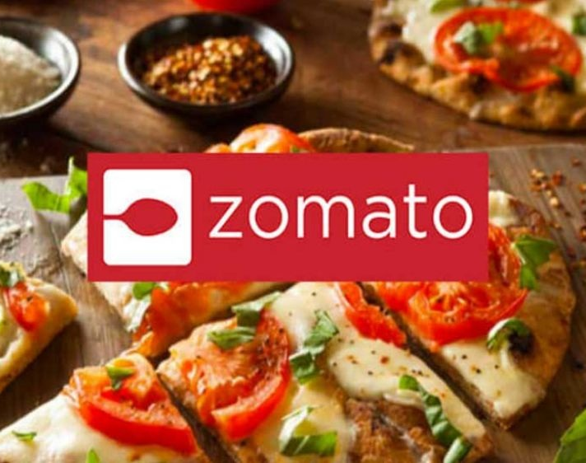
ZOMATO RESTAURANT CASE STUDY
BY TANIA DAS

Slide 2
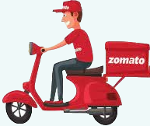
BUSINESS PROBLEM
In a busy city like Bangalore where people hardly have time to cook for themselves, most of them depends on restaurants.
There has been an increasing demand over the years for restaurants.
Starting a new restaurant in this city would not be a bad idea, but before setting up an establishment one needs to check some factors.

Slide 3
OBJECTIVES
What are Bangaloreans favourite cuisines ?
As a new entrant into the restaurant business, should one go for Indoor Seating, Takeaways or Home-Delivery?
Deciding the area for setting up a new venture, the top 10 areas that has the maximum number of restaurants linked with Zomato?
What’s should be the average cost for a new restaurant?
What should one go for? A veg restaurant or a non-veg restaurant?
3

Slide 4
If someone wants to open a franchise, then he/she would like to know for which franchise they should go for?
What are the few dishes that are must to include in the menu of a new restaurant?
Is a more expensive restaurant also better rated?
If someone wants to open a new restaurant and wants to be known among people for “Quick Service” then he/she would like to know which are the top few areas where people look for “Quick Service” in the restaurants.
4

Slide 5
DATA

Slide 6
DATA DICTIONARY
Total 19 columns
11 important columns used:
Name-Name of the restaurant
Cuisines- Cuisines offered by the restaurant
Area- Area where the restaurant is located
IsHomeDelivery-Whether home delivery is available or not
IsTakeaway-Whether takeaway is available or not
IsIndoorSeating-Whether indoor seating is available or not
IsVegOnly-Whether the restaurant is veg or not
Delivery Ratings-Ratings given during delivery
PopularDishes-Popular dishes of the restaurant
PeopleKnownFor-For what quality it is famous among people
AverageCost – Average cost for people

Slide 7
PROJECT WORKFLOW
Raw Data
Data was in csv format with 8923 rows and 19 columns
Data Cleaning
Missing value
Summarization
Pivots
Analysis
Created charts
Derived insights

Slide 8
CUISINES
People of Bangalore likes South Indian food the most followed by North Indian

Slide 9
AMENITIES
Home Delivery is the most preferred amenity

Slide 10
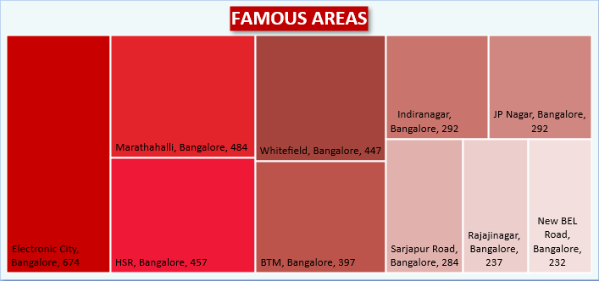
RESTAURANT LOCALITIES
Electronic City is the most famous area for restaurants followed by Marathahalli in Bangalore

Slide 11
RESTAURANT
Maximum number of restaurants are in the average cost range of 50-249
In the city of Bangalore , Five Star Chicken has the maximum number of outlets followed by Kwality Wallâ€™s Frozen Dessert and Ice Cream Shop

Slide 12
VEG VS NON-VEG RESTAURANT
Only 7% of the restaurants are veg whereas 93% of the restaurants are non-veg

Slide 13
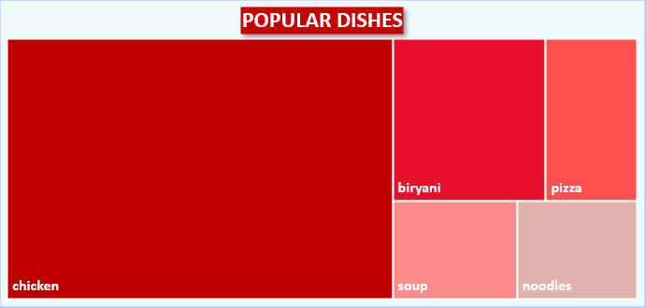
MUST HAVE DISHES ON MENU
Popular dishes on menu are chicken, biryani, pizza, soup , noodles

Slide 14
COST VS DINNER RATING RELATIONSHIP
There is positive but not so strong relationship between dinner ratings and average cost

Slide 15
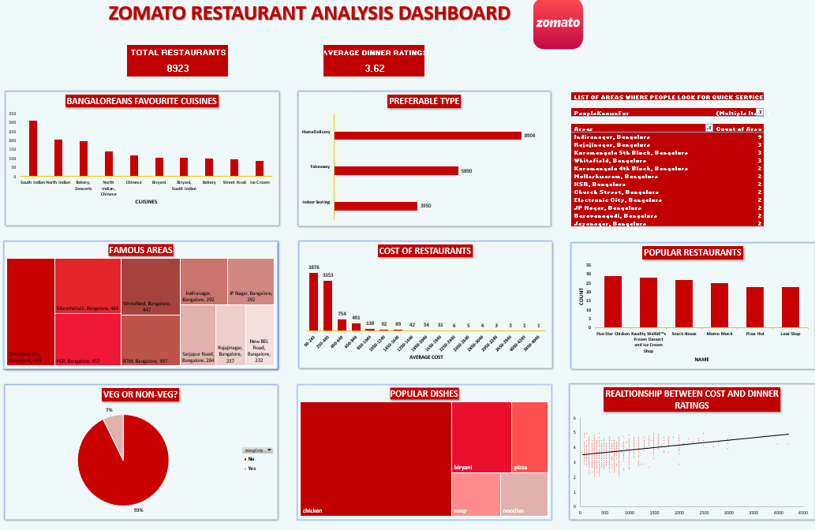

Slide 16
INSIGHTS
Bangaloreans favourite cuisine is South Indian food.
As a new entrant into the restaurant business, one should opt for homedelivery facility since most of the restaurants offer home delivery.
The area for setting up a new venture should be Electronic city as it has the maximum number of restaurants. So, we can conclude that it is the most famous area for restaurants.
Average cost for a new restaurant should be in the range of 50-249 as most of the restaurants are in this range.
If someone wants to open a franchise, then he/she should go for Five Star Chicken as it has the maximum number of outlets in Bangalore.
One should opt for non-veg restaurants as Bangalore has more non-veg restaurants as compared to veg restaurants if he/she is an new entrant into the business
The few dishes that are must to include in the menu are the ones that contains words like chicken, biryani, soup, noodles, pizza in their names.
There is positive but not so strong relationship between dinner ratings and average cost. We can say as cost increases ratings also increases.

Slide 17
THANK
YOU

